Slide 1
CP3405 TR2 2026
Wenhan Hu, Yijie Kan, The Bao Le, Yu-Chu Lin, Junwen Lu, Guanyu Lu, Hamzah Nutt, Swan Htet Zaw, Hao Wang, Qinyang Wu, Zaikun Zheng, Yue Zhou

Slide 2
R1- Week 3 Sprint Direction
Week 3: evidence-balance prediction
Product Owner: The Bao Le
Sprint Goal
Almanac - seasonality
Produce a balanced market prediction for SPX, NDX, and IWM by comparing Almanac, Macro, Technical, and Multi‑LLM evidence before deciding final direction and confidence.
Macro - events & risk
Technical - trend & breadth
Quality target: improve confidence calibration, not just directional accuracy.
Multi-LLM - consensus check
Calibration Results
Definition of Done
Evidence updated
Multi‑LLM comparison completed
Human Score + override completed
Prediction committed
+4
Week 2 Score
2 HIT
SPX / NDX
1 MISS
IWM
Notes:
Our goal is to create a balanced prediction for SPX, NDX, and IWM by using evidence from Almanac, Macro, Technical, and Multi-LLM outputs before deciding our final direction and confidence.
From Week 2, we scored +4, with SPX and NDX correct, but IWM missed. This showed that market strength was selective, not broad.
Therefore, our main improvement target this week is confidence calibration. We want to avoid being overconfident when evidence is mixed.
The sprint is complete when the final prediction, comparison table, Human Score, and evidence are committed.

Slide 3
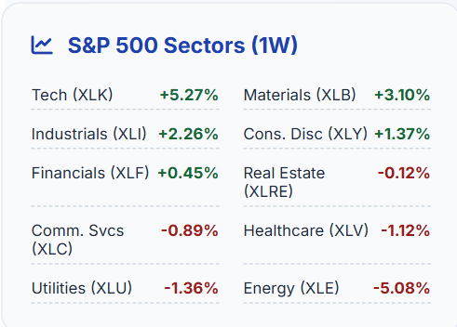
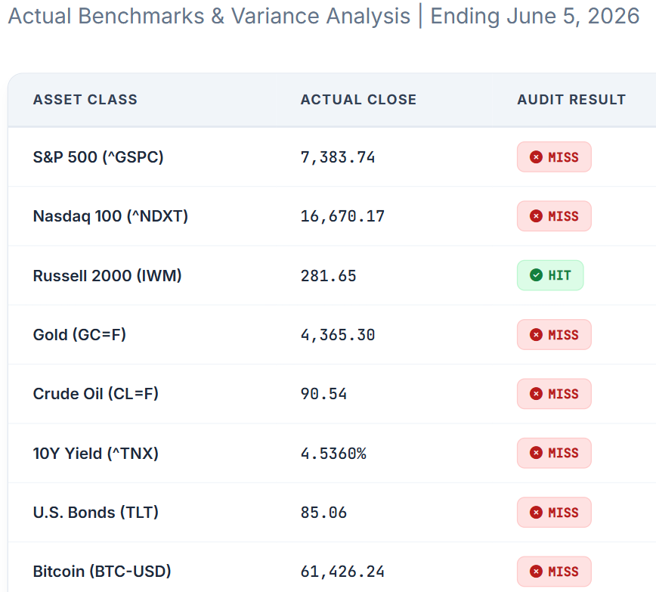
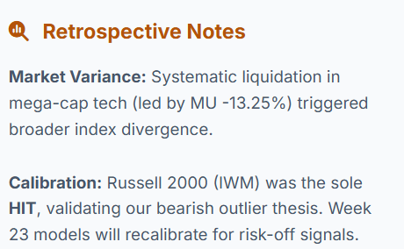
R8 Data Lead
Notes:
This week, our models faced systematic variance, registering 1 HIT and 7 MISSES. While major indexes and commodities deviated due to sudden market pullbacks, our bearish outlier thesis for small-cap equities was fully validated, yielding a definitive HIT on the Russell 2000 (IWM).
This divergence was primarily driven by localized liquidations in tech—specifically a 13.25% earnings drag from Micron Technology—which disrupted standard index correlations. For Week 23, we are recalibrating our models with a higher volatility coefficient to better capture these rapid sector rotations.

Slide 4
R3 Almanac Lead
Sector signals:
Sector | Window | Start | End | Avg % return
Financials (XLF) | SHORT | B. May | B. Jul | -6.3%
Gold (XAU) | SHORT | M. May | E. Jun | -6.8%
Materials (XLB) | SHORT | M. May | M. Oct | -5.1%
Oil (XLE) | SHORT | B. Jun | E. Aug | -5.7%
Technology (XLK) | LONG | M. Mar | M. Jul | +10.9%
Utilities (XLU) | LONG | M. Mar | E. Oct | +9.3%
Vital stats:
Index | Rank | Avg % change
S&P 500 | 9 | +0.2%
S&P 500 (mid-term year) | 9 | -2.1%
NASDAQ | 6 | +1.0%
Russell 2000 | 7 | +0.8%
Week-specific notes:
Mixed record, no dominant pattern
Conclusion:
Almanac seasonal bias: BEARISH-NEUTRAL
Pattern confidence: MEDIUM
Notes:
Go through the tables briefly, point out the contradiction in utilities because of yields at 4.60%, then go through seasonal bias and remaining stuff

Slide 5
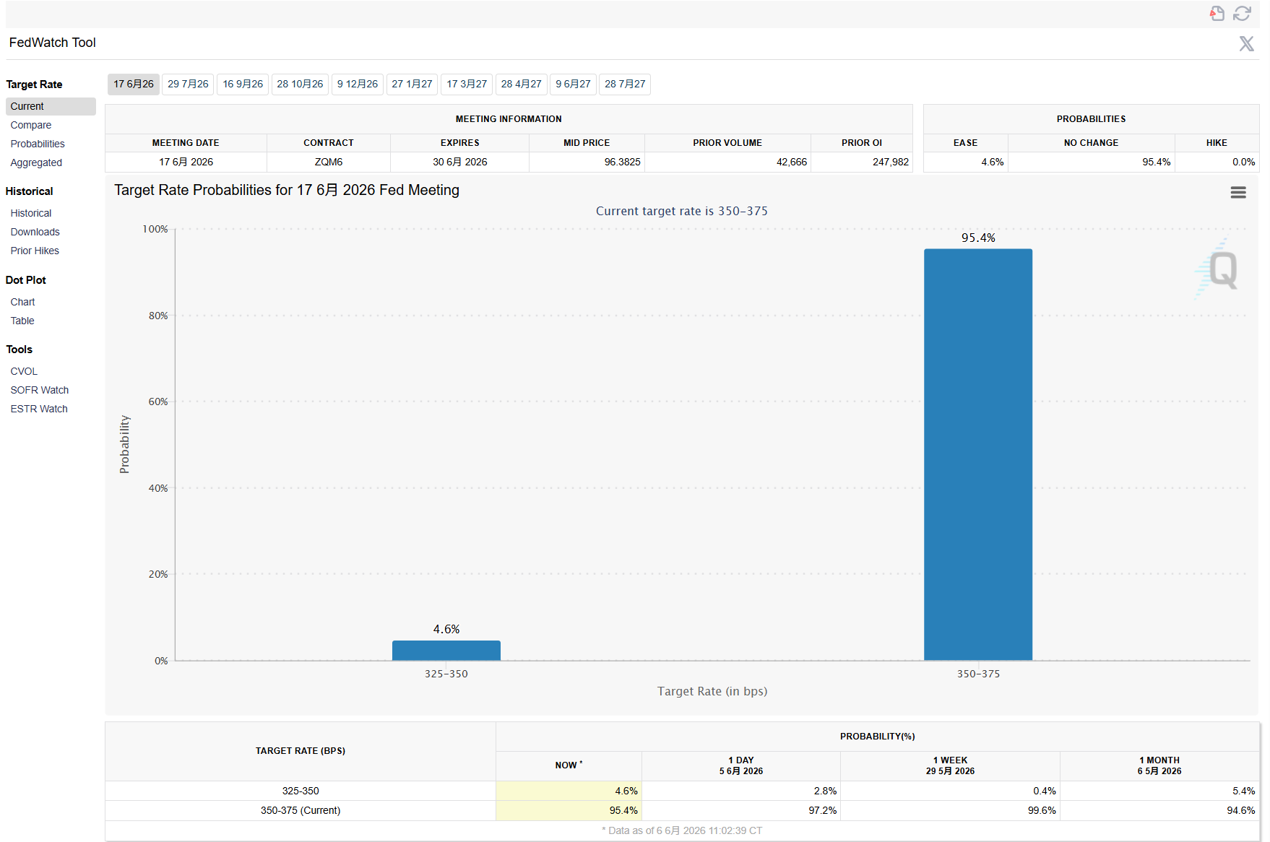
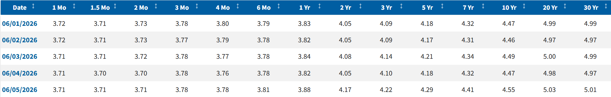
R4 Macro Lead
Federal Reserve
• 95.4% probability of no rate change
• Market expects rates to remain stable
Treasury Yield
• US 10Y Yield: 4.55%
• Higher yields may pressure growth stocks
Key Events This Week
• CPI
• PPI
• Initial Jobless Claims
Iran Risk
• US sanctions on Iran remain in place
• Geopolitical tensions may affect oil prices
Macro Bias
Neutral to Slightly Bullish
Primary Driver
US CPI Report
Notes:
P1: This week, the Federal Reserve remains a key market driver.
According to FedWatch, there is a 95.4 percent probability that the Fed will keep interest rates unchanged.
Treasury yields remain elevated, with the US 10-year yield at 4.55 percent.
Higher yields may create pressure on growth and technology stocks.
P2:
Important economic events this week include CPI, PPI, and Initial Jobless Claims.
We are also monitoring geopolitical risks related to Iran, as sanctions and regional tensions may affect oil prices and market sentiment.
Overall, our macro bias is neutral to slightly bullish.
The most important macro event this week is the US CPI report, which may influence future Federal Reserve expectations.

Slide 6
R5 Technical Lead
SPX,NDX,IWM are 3 stocks I am observe.
Based on the indicator 8 EMA and 21 EMA, we could predict the trend whether it will bullish or bearish.
Because of the stock market changing in an instant, so we choose the tag on 1D.

Slide 7
R6 LLM Operator
Model | Direction | Bias | Confidence | Macro Driver
ChatGPT | Down | Neutral-Bearish | Medium | U.S. CPI and PPI Inflation Reports
Claude | Down | Neutral-Bearish | Medium | U.S. CPI Report
Gemini | Down | Neutral-Bearish | Medium | U.S. CPI and PPI Inflation Data
DeepSeek | Down | Neutral-Bearish | Medium | U.S. CPI Report
Unanimous Call:
Direction: DOWN
Risk Profile:
Neutral-Bearish
Trading Range:
7,360 – 7,420
Technical Signal:
Below 8/21 EMAs
Notes:
Hello, everyone. This slide highlights a rare, unanimous consensus among the world's top four AI models—ChatGPT, Claude, Gemini, and DeepSeek—for Week 23 of 2026.
As you can see in the comparison table, there is absolute alignment across the board:
Direction & Bias: Every model holds a Neutral-Bearish outlook.
Confidence: They all rate their confidence as Medium, indicating a steady, calculated downside risk rather than a sudden panic.
Macro Driver: The primary catalyst identified by all models is the upcoming U.S. CPI and PPI Inflation Reports, which will heavily impact the 10-year Treasury yield.
The models have locked in an expected weekly trading range of 7,360 to 7,420. Given the technical breakdown below the 8 and 21-day EMAs, the consensus strategy here is clear: manage risk cautiously and treat short-term rallies as opportunities to de-risk.

Slide 8
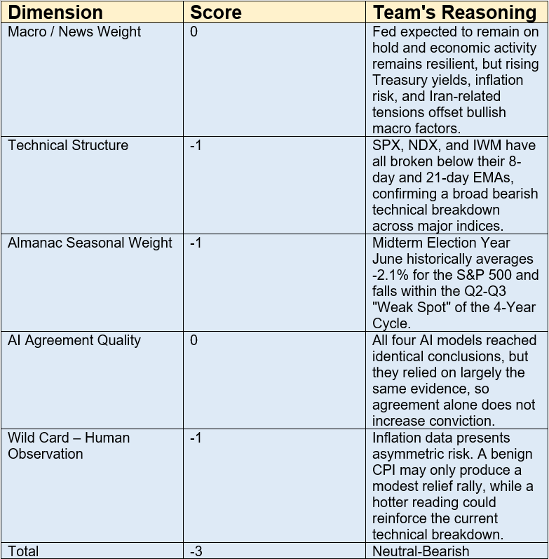
R7 Human Score
The Human Score is slightly more cautious than the AI consensus. Bearish technical conditions, weak midterm-year seasonality, and inflation-related event risk outweigh the relatively stable macro backdrop, supporting a Neutral-Bearish outlook.
Notes:
Our key human insight was that inflation risk remains asymmetric. A favorable CPI report may only produce a modest rebound, while a hotter reading could reinforce the current technical breakdown. Combined with weak June seasonality and all major indices trading below their 8-day and 21-day EMAs, this supports our Neutral-Bearish outlook.

Slide 9
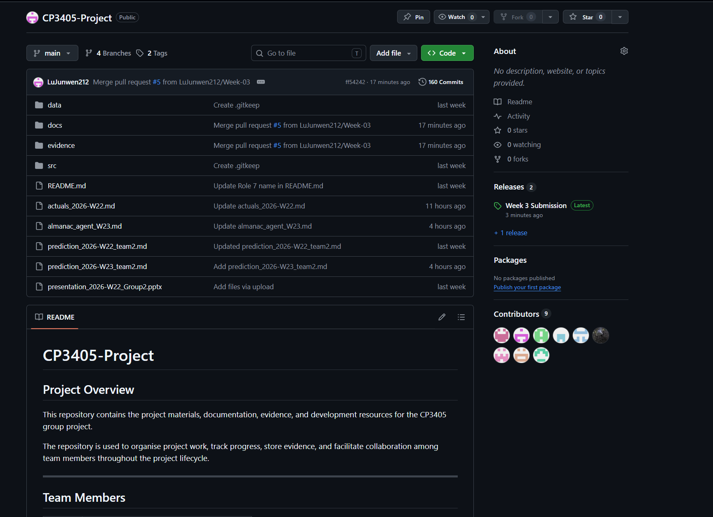
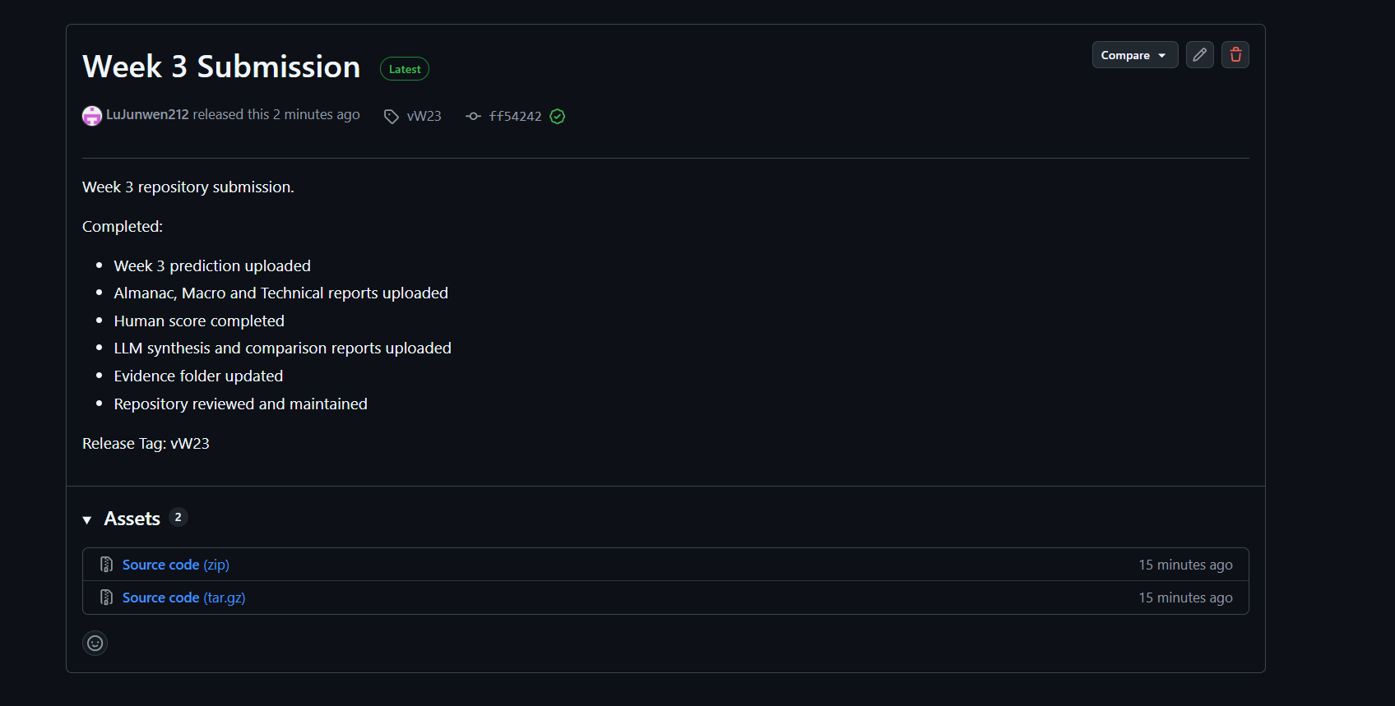
R9 GitHub Lead

Slide 10
R10 QA Lead
QA Check — Week 03 / W23
Checked evidence:
• Almanac: Bearish-Neutral
• Macro: CPI/PPI risk
• Technical: weak structure
• LLM: 4/4 DOWN
• Human Score: -3
R10 finding:
• Neutral-Bearish outlook is supported
• Final prediction is not only based on AI
• AI consensus matches Human Score and market evidence
Learning:
• Compare AI output with human judgment before final prediction
Notes:
I am R10, the QA Lead and Learning Log Lead.
For Week 03 / W23, I checked whether the final prediction is supported by evidence.
The Almanac result is bearish-neutral. The macro section highlights CPI, PPI, inflation risk, and Treasury yield pressure. The technical section shows weak market structure.
All four AI models predict DOWN, and the Human Score is -3, so the overall view is neutral-bearish.
My QA finding is that the final prediction is not only based on AI consensus. It is also supported by human judgment and market evidence.
The key learning is: do not copy AI directly. Compare AI output with Human Score before the final prediction.

